Slide 1
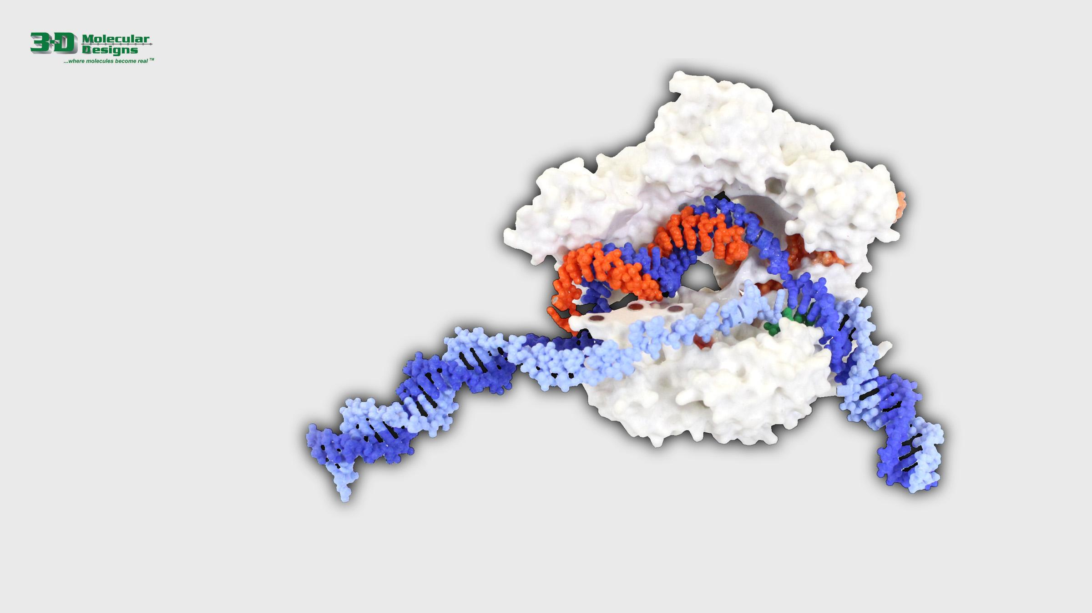
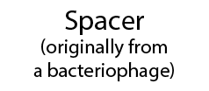

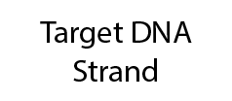


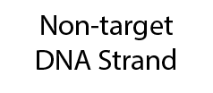
Labeling CRISPR-Cas9
To the right is a visual representation of the CRISPR-Cas9 protein.
Using the movable labels below, annotate this visual representation with the correct terms.
What are some strengths and weaknesses to this particular representation of the Cas9 protein?

Slide 2
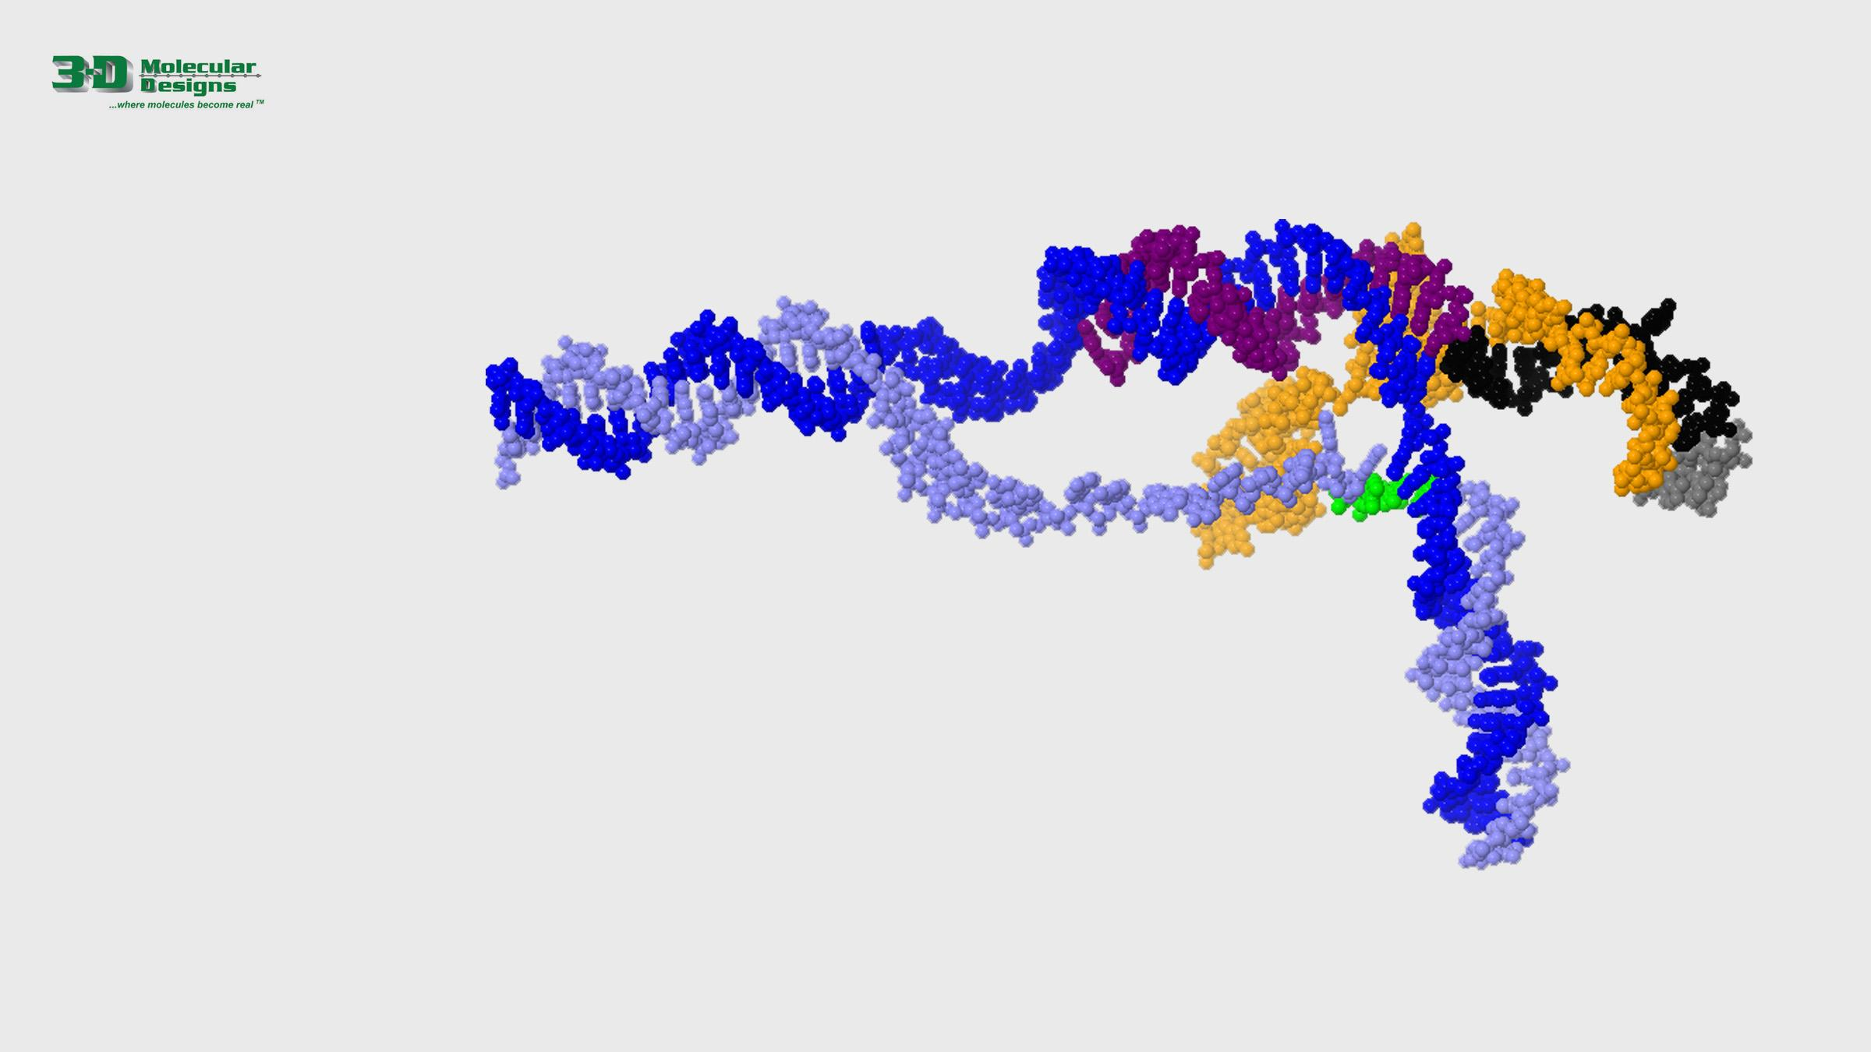



Labeling DNA and guideRNA
To the right is a visual representation of the CRISPR-Cas9 protein.
Using the movable labels below, annotate this visual representation with the correct terms.
What are some strengths and weaknesses to this particular representation of the Cas9 protein?

Slide 3
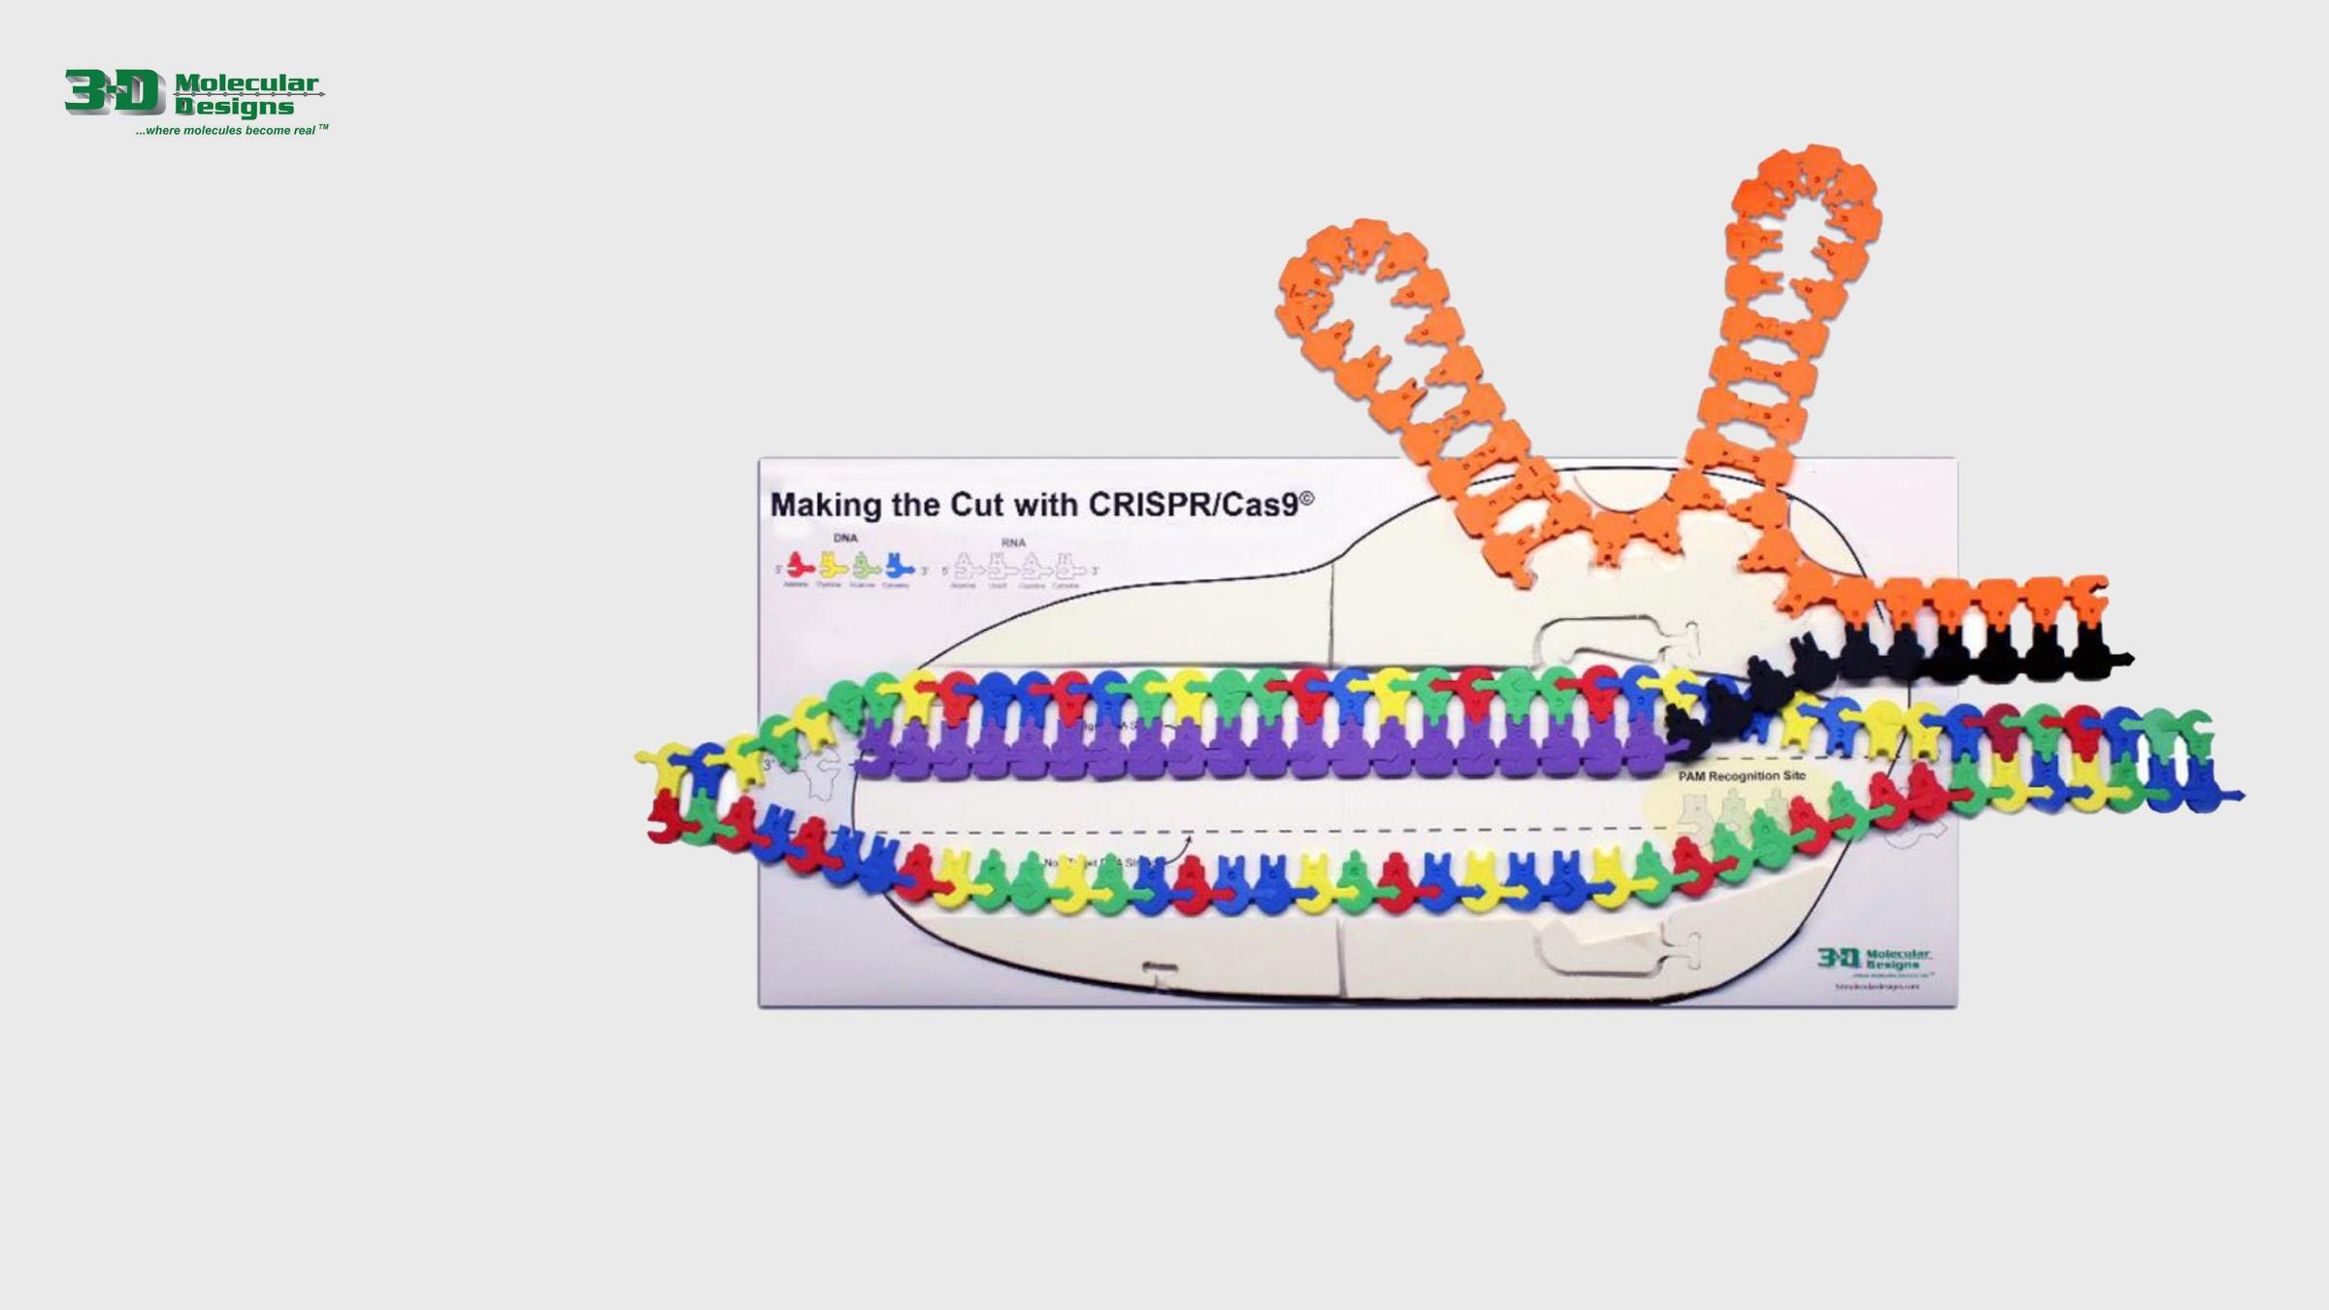


Labeling CRISPR-Cas9
To the right is a visual representation of the CRISPR-Cas9 protein.
Using the movable labels below, annotate this visual representation with the correct terms.
What are some strengths and weaknesses to this particular representation of the Cas9 protein?

Slide 4

Labeling CRISPR-Cas9
To the right is a visual representation of the CRISPR-Cas9 protein.
Using the movable labels below, annotate this visual representation with the correct terms.
What are some strengths and weaknesses to this particular representation of the Cas9 protein?

Slide 5
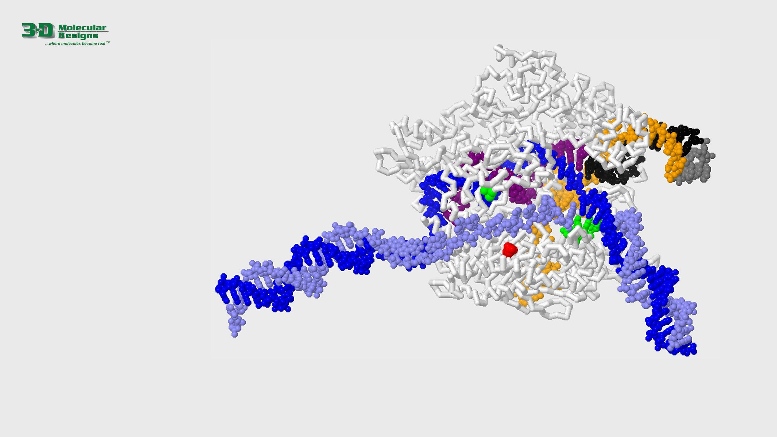
Labeling CRISPR-Cas9
To the right is a visual representation of the CRISPR-Cas9 protein.
Using the movable labels below, annotate this visual representation with the correct terms.
What are some strengths and weaknesses to this particular representation of the Cas9 protein?

Slide 6

Activity Questions:
Add questions as needed for your classroom and student level.

