Slide 1
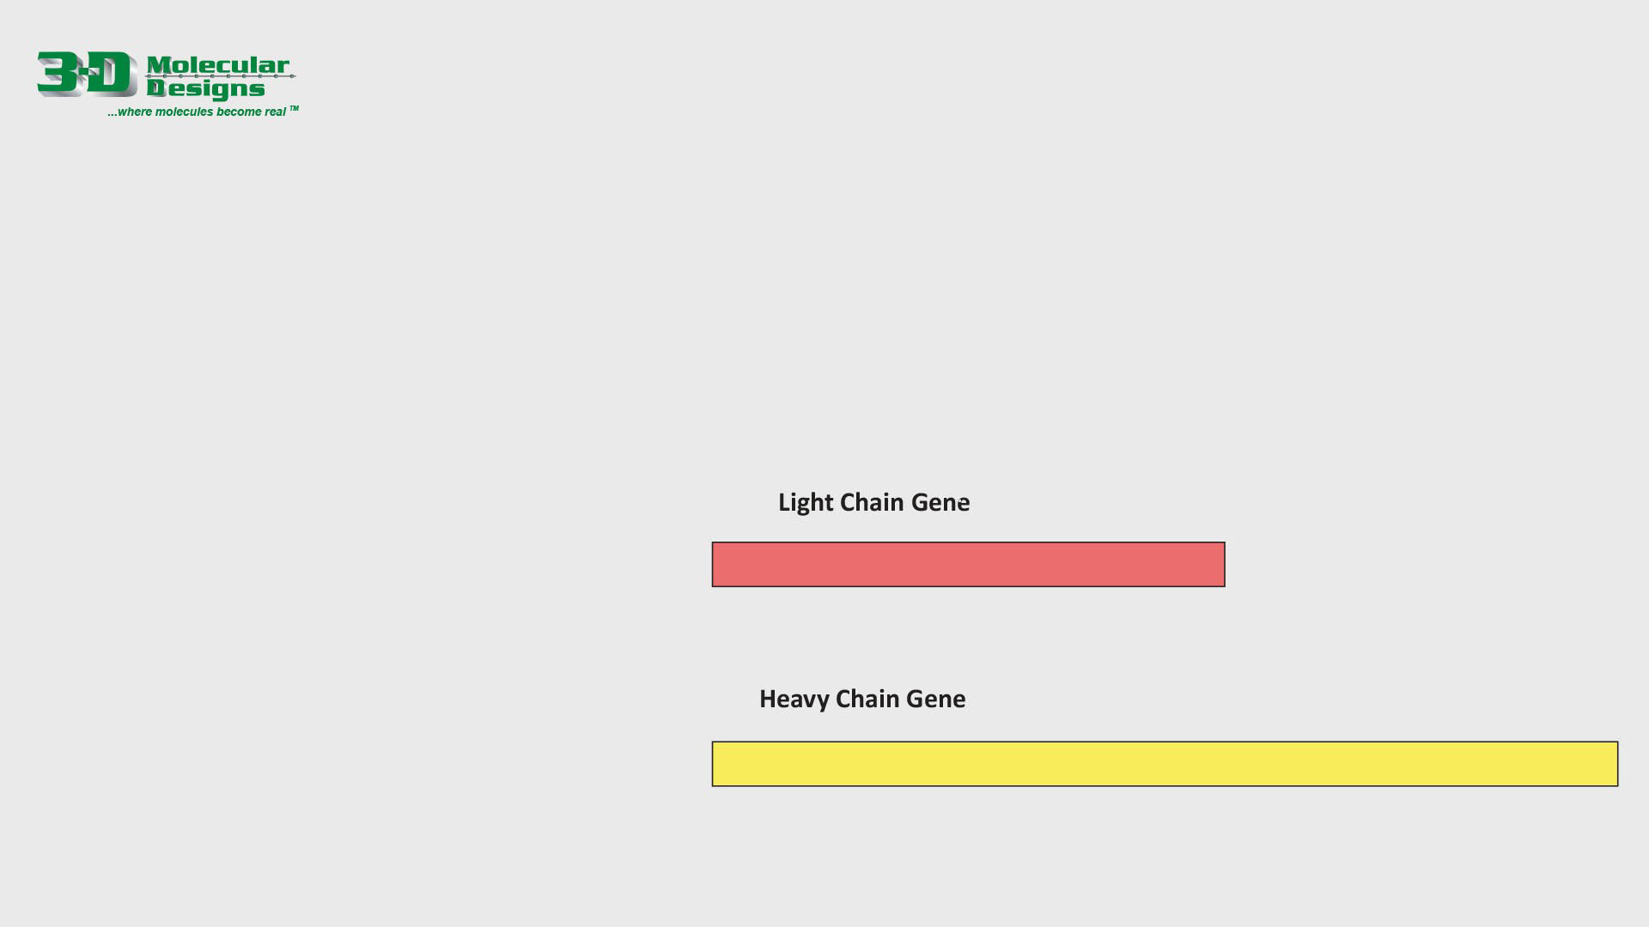









Shuffling the Antibody Gene
Antibody diversity is the result of the antibody gene being shuffled differently in each antibody-producing B-cell. The light chain gene has several different V and D regions, and the heavy chain gene has several different V, D and J regions. As each B-cell matures, a single copy of each region is retained, and the other copies are deleted.
Using the movable V, D and J regions below, remove all but one copy of each region – building a unique antibody gene in the process.
Antibody genes are further diversified by cropping small regions off the beginning or end of each V, D or J region. Demonstrate this using the PowerPoint “Crop” tool to remove a bit at the beginning or end of each V, D or J region. The crop tool is available on the right side of the “Picture Format” tab at the top of the window.

Slide 2
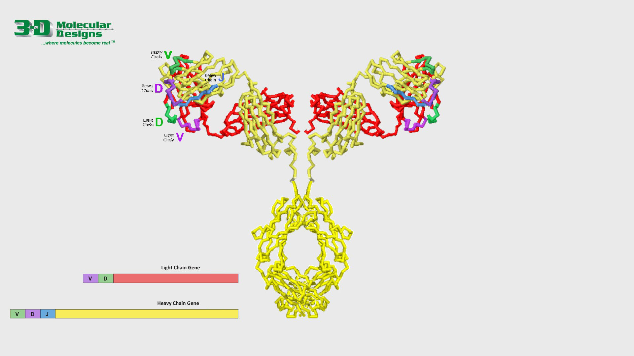
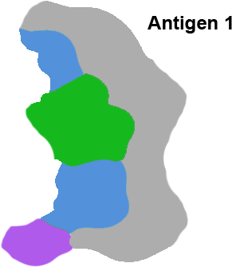
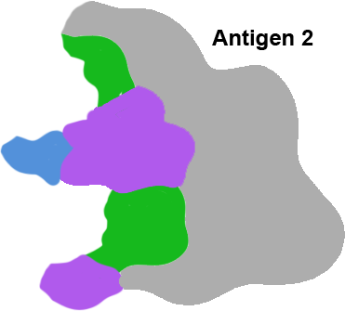
Antigen Binding
The unique shuffling of the V, D and J regions in the heavy chain gene and the V and D regions in the light chain gene result in a unique translated antibody protein.
This unique antibody protein will bind to a specific antigen that complements its antigen binding domain. Move the two antigens shown on the far right to see which antigen might bind best to this unique antibody.

